Slide 1


“Prediction is very difficult, especially if it's about the future.”
San Juan County and Orcas Island Census County Division Economic Review
By: Reinhold Groepler, Ph.D., Regional Economist
Date: March 8, 2012
Washington State
Employment Security Department
Labor Market and Economic Analysis

Slide 2
Overview of Presentation
From the National Economy to the Local Economy
Leading Economic Indicators and Indexes
  How do they work?; What are they telling us about the national economy?
  What are they telling us about economic conditions in San Juan County?
Industry Employment in San Juan County
  What are the shares of employment by industry?
  What are the employment trends by industry?
Commuting and Jobs in the Orcas Census County Division (San Juan County slides in appendix)
Sources: ESD/LMEA, BLS, CES

Slide 3
Leading Indicators 101
Coincident Indicators
What we care about in an economy:
  Employment: Jobs generate income and consumption.
  Income: This generates sales and employment.
  Sales and Consumption: This creates jobs and income.
These are called coincident economic indicators as they are most important.
  These three indicators are statistically ‘hammered’ together into a coincident economic index (CEI).
  The economy is growing when the CEI rises and can be in recession if the CEI falls far enough.
Notes:
The most commonly used leading indicators to produce the national CEIs are:
1) All Employees: Total Nonfarm (SA, Thous) NOTE: LMEA CEIs all use Total Nonfarm Private and exclude public employment because of shifting seasonal trends in most Washington counties.
2) Real Personal Income Less Transfer Payments (SAAR, Bil.Chn.2005$) NOTE: Total public and private wages is used at the county level.
3) Industrial Production Index (SA, 2007=100) NOTE: Not Available at the state and local levels.
4) Real Manufacturing & Trade Sales: All Industries (SA, Mil.Chn.2005$) Note: Taxable Retail sales are used at the county level.
At this point a CEI has not been created for Skagit County, so nonfarm private employees is being used as a substitute.

Slide 4
Leading Indicators 101
Coincident Indicators: Employment
Notes:
Data through December 2011

Slide 5
Leading Indicators 101
Coincident Indicators: Income
Notes:
Since wage earners buy food and energy, the nominal values are deflated using the core CPI including food and energy.

Slide 6
Leading Indicators 101
Coincident Indicators: Sales & Consumption
Notes:
Since Food and Energy are generally not subject to the sales tax, they are excluded in the inflation adjustment

Slide 7
Leading Indicators 101
Coincident Indicators

Slide 8
Leading Indicators 101
Leading Indicators and Business Cycles
Leading indicators change direction before coincident indicators change.
This helps economists to anticipate recessions and recoveries.
A leading economic index (LEI) consists of statistically ‘hammering’ many different leading indicators together into one LEI to forecast future economic conditions.

Slide 9
Leading Indicators 101
Stylized Business Cycles
Notes:
LEIs lead recessions by 6-18 months or more depending on the individual leading inputs.
LEIs bottom out shortly before a recession ends, sometimes by only 3-4 months or even less!
The stylized graphs above do not show this, but the LEIs in the next few charts do!

Slide 10
Leading Indicators 101
Initial claims for unemployment insurance benefits are an important short-leading indicator.
As initial claims fall, that signals a
pickup in jobs within 3-6 months.

Slide 11
Leading Indicators 101
Discretionary spending: important short-leading indicator

Slide 12
Leading Indicators 101
National credit market conditions are important leading indicators
The more negative the yield spread between ‘risk free’ US Treasuries and lower rated corporate debt, the more difficult it is for small businesses to get credit

Slide 13
Leading Indicators 101
National credit market conditions are important leading indicators
As the yield differential between longer term interest rates and shorter term interest rates decreases, it is less profitable for banks to lend.

Slide 14
Leading Indicators in Practice
US business cycles and the US long-leading index
Sources: LMEA; Underlying data sources from HAVER Analytics.

Slide 15
Industry Employment
San Juan County, December 2011
Notes:
Year over year compares the last months data (12/2011 in this case) with the same month last year (12/2010 in this case. Since this data is not seasonally adjusted (SA) this give a good picture on how employment has changed compared to last year.
Comparing month over month (November 2011 to December 2011) using the nonseasonally adjusted data (NSA), does not give a true picture over the month due to seasonal effects. The slide two pages down gives SA trends to see the changes over the past few months.

Slide 16
Industry Employment
Area Comparisons: December 2011

Slide 17
Industry Employment
San Juan County: December 2011

Slide 18
Industry Employment
San Juan County: December 2011

Slide 19
‘Headline’ Unemployment Rates
December 2011: U-3 rate

Slide 20
Unemployment Rates Beyond The Headline Rate (U-3)
The U6 minus U5 rate gives the percentage of the labor force involuntarily working part-time for economic reasons (could not find a full-time job).
Notes:
U-1, persons unemployed 15 weeks or longer, as a percent of the civilian labor force;
U-2, job losers and persons who completed temporary jobs, as a percent of the civilian labor force;
U-3, total unemployed, as a percent of the civilian labor force (this is the definition used for the official unemployment rate);
U-4, total unemployed plus discouraged workers, as a percent of the civilian labor force plus discouraged workers;
U-5, total unemployed, plus discouraged workers, plus all other marginally attached workers, as a percent of the civilian labor force plus all marginally attached workers; and
U-6, total unemployed, plus all marginally attached workers, plus total employed part time for economic reasons, as a percent of the civilian labor force plus all marginally attached workers.
U-6 minus U-5 is a measure of workers employed part time that would rather be employed full time.
U-6 Rates ordered from highest for 2010Q4-2011Q3: NV 23.3%; CA 21.6%; MI 19.2%; RI 18.7%; WA 18.5%; FL 18.2%; OR & NC 17.9%

Slide 21
Long-Term Unemployment
Among the Insured Unemployed
Persons unemployed 27 weeks or longer are considered the long-term unemployed
In San Juan County, that is a 37.5% share, which compares to:
  40 percent for Skagit County
  47 percent for Island County
  50 percent in Snohomish County
  44 percent statewide.
Notes:
Those unemployed 27 weeks or longer are considered long-term unemployed. As unemployment spells become longer for individuals, it gets progressively more difficult on average for those individuals to find reemployment as employers prefer those without long unemployment spells. Therefore the danger is that these people become structurally unemployed (loss or lack of skills that employers are looking for in new hires) for even longer spells. A fresh start based on education and/or training may be the keys to break this cycle for the long-term unemployed.
1Regular Benefits: up to 26 weeks of benefits. Paid from the state UI trust fund. Training benefits are excluded from these figures.
2Emergency Unemployment Compensation (EUC): up to 53 weeks continued compensation after regular benefits expire.
3Extended Benefits (EB): up to 20 weeks continued compensation after EUC expires. Extended benefits are normally 50 percent state funded and 50 percent federally funded for those employers who
pay UI taxes. The federal government has paid 100% of EB since Washington State became eligible in February 2009. Recent legislation extended 100 percent federal funding of EB through 2011.
4Training Benefits: Up to 52 weeks of continued compensation to those claimants that are in approved training programs and paid after any regular and extended benefit are exhausted. Benefits paid are
52 weeks times the wba less and regular and eb benefits paid. Recent legislation will change the order of priority after 07/03/11 to be paid after all federal benefits have been exhausted.
5Total claimants: unduplicated count of all UI claimants who received a UI payment in the month. Because claimants may receive more than one benefit type in a month, the separate totals for EUC, EB
and regular benefits cannot be combined to form a total count of individuals who received some form of UI payment in the month
6Exhaustees: Claimants who have exhausted all UI benefit entitlements since EUC was implemented in July 2008.
7OOS/Other: Washington claimants residing out-of-state or with non-recognizable street addresses in WA.
Source: Employment Security Department, 1/17/2012

Slide 22
How San Juan Industries Compare for With Washington State: Location Quotients
1) A location quotient tells us the relative importance of the number of employees in a local Industry compared to a state or the US.
2) For example, if a local location quotient for government were 1.0 that implies that the percentage of all employees working in government would be the same for the locality as well as the state.
3) Location quotients less than 1 mean the local industry has fewer employees in that industry on a percentage basis than the state.
Notes:
Employment (UI Covered) Location Quotients (QCEW data): San Juan County: Washington State
NAICS Code Industry
11 Agriculture, forestry, fishing and hunting 0.31
111 Crop production 0.34
21 Mining NA
22 Utilities 8.89
23 Construction 2.59
236 Construction of buildings 4.84
237 Heavy and civil engineering construction 0.96
238 Specialty trade contractors 2.05
31-33 Manufacturing 0.37
311 Food manufacturing 0.88
327 Nonmetallic mineral product manufacturing 1.14
331 Primary metal manufacturing 0.00
332 Fabricated metal product manufacturing 0.34
42 Wholesale trade 0.31
423 Merchant wholesalers, durable goods 0.19
424 Merchant wholesalers, nondurable goods 0.39
425 Electronic markets and agents and broker 0.56
Other industries
44-45 Retail trade 1.17
441 Motor vehicle and parts dealers 0.62
443 Electronics and appliance stores 0.56
444 Building material and garden supply stores 2.74
445 Food and beverage stores 2.28
446 Health and personal care stores 1.59
447 Gasoline stations 2.67
448 Clothing and clothing accessories stores 0.29
451 Sporting goods, hobby, book and music stores 0.95
453 Miscellaneous store retailers 1.09
454 Nonstore retailers 1.28
48-49 Transportation and warehousing 0.70
484 Truck transportation 0.20
487 Scenic and sightseeing transportation 33.16
488 Support activities for transportation 0.54
51 Information 0.33
517 Telecommunications 0.67
52 Finance and insurance 0.63
522 Credit intermediation and related activities 0.83
53 Real estate and rental and leasing 1.06
531 Real estate 1.23
532 Rental and leasing services 0.51
54 Professional and technical services 0.48
541 Professional and technical services 0.48
55 Management of companies and enterprises NA
56 Administrative and waste services 0.82
561 Administrative and support services 0.82
562 Waste management and remediation service 0.78
61 Educational services 0.82
62 Health care and social assistance 0.58
621 Ambulatory health care services 0.55
622 Hospitals NA
623 Nursing and residential care facilities 1.04
624 Social assistance 0.90
71 Arts, entertainment, and recreation 1.86
713 Amusements, gambling, and recreation 1.87
72 Accommodation and food services 2.43
721 Accommodation 9.44
722 Food services and drinking places 1.35
81 Other services, except public administration 1.13
811 Repair and maintenance 0.73
812 Personal and laundry services 1.08
813 Membership associations and organization 1.64
814 Private households 1.08
GOVERNMENT 1.05
Federal Government 0.57
State Government 0.50
Local Government 1.38

Slide 23
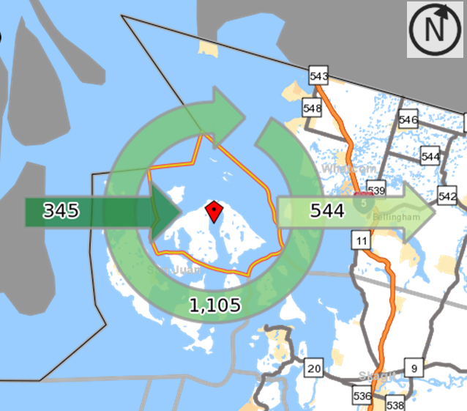
Orcas Commute Patterns
Combining ESD Employment Data on Jobs by Place of Work
with Federal Data on Place of Residence Yields Commuting Patterns
Notes:
OnTheMap: Independent Survey data on work commutes by Census Transportation Planning Products suggests that the commuter Outflow may be overstated. OTM is partially algorithmic and some employers may misstate the place of worker duties at a headquarters location instead of the actual place where the work was performed---these would be the major sources of possible inaccuracies.
http://ctpp.transportation.org/Pages/3yrdas.aspx
Census County Division (CCD) Definition:
http://en.wikipedia.org/wiki/Census_county_division
A Census County Division (CCD) is a subdivision of a county used by the United States Census Bureau for the purpose of presenting statistical data. A CCD is a relatively permanent statistical area delineated cooperatively by the Census Bureau and state and local government authorities. CCDs are defined in 21 states that do not have well-defined and stable minor civil divisions (e.g., townships) with local governmental purposes.^{[1]}
CCDs are not governmental units and have no legal or governmental functions. Their boundaries usually follow visible features, such as roads, railroads, streams, power transmission lines, or mountain ridges, and coincide with the boundaries of census tracts. CCDs do not span county lines. Each CCD is given a name based on the name of the largest population center in the area, a prominent geographic feature, the county name, or another well-known local name that identifies its location.^{[1][2]}
CCDs were first implemented for tabulation of 1950 Census data from the state of Washington. As of the 1990 census, a total of 5,581 CCDs were defined in 21 states.^{[2]}

Slide 24
Orcas CCD Commute Patterns:
Work Destinations of Orcas Workers

Slide 25
Orcas CCD Worker Industry Employment
(Jobs held by residents, regardless of job location)
Notes:
Source: Employment Security Department/LMEA/OnTheMap
For example:
There was an average of 208 workers in Accomodation and Food Services residing in Orcas CCD (regardless of where they worked).
There was an average of 274 jobs in Accomodation and Food Services in Orcas CCD.
This means there was a net inflow of 66 workers to Orcas working in this industry.

Slide 26
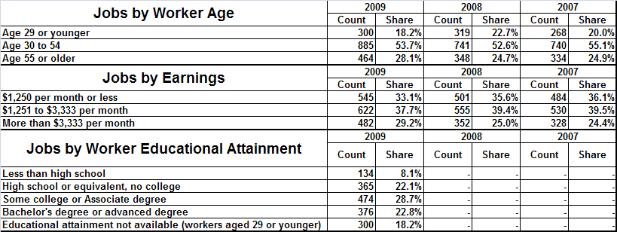
Orcas CCD Worker Characteristics
For the residents of Orcas (regardless of work location)

Slide 27
Orcas CCD Work Commute Patterns
Net Outflow: Industry Destinations
Source: Employment Security Department/LMEA/OnTheMap
Notes:
Source: Employment Security Department/LMEA/OnTheMap
For example:
There was an average of 208 workers in Accomodation and Food Services residing in Orcas CCD (regardless of where they worked).
There was an average of 274 jobs in Accomodation and Food Services in Orcas CCD.
This means there was a net inflow of 66 workers to Orcas working in this industry.

Slide 28
Appendix Slides
Useful LMI Links (including Orcas Island)
Deeper Look at the Unemployed (US)
WDA-3 Occupational Projections
San Juan County Commute/Jobs Patterns
Common Leading Indicators

Slide 29
Links to LMI From ESD and other Websites
State & Local Links
Guide on how to find LMI on new ESD website (crosswalk from old website):
https://fortress.wa.gov/esd/employmentdata/help/cross-walk
Northwest Washington Labor Market Review (4-County Region)
http://nwboard.org/impact/laborareasummaries.html
County Data Releases (AKA Labor Area Summaries)
https://fortress.wa.gov/esd/employmentdata/eeis-tools/labor-area-summaries
Employment Projections
https://fortress.wa.gov/esd/employmentdata/reports-publications/industry-reports/employment-projections
Find Employers
https://fortress.wa.gov/esd/employmentdata/reports-publications/industry-reports/find-employers
Find Occupations (Use filters to narrow your search)
https://fortress.wa.gov/esd/employmentdata/reports-publications/occupational-reports/occupations-in-demand
LMI Numbers and Trends by Area
https://fortress.wa.gov/esd/employmentdata/reports-publications/regional-reports/numbers-and-trends
Long Term Industry Trends by Area
https://fortress.wa.gov/esd/employmentdata/reports-publications/industry-reports/industry-trends
Quarterly Census of Employment and Wages
https://fortress.wa.gov/esd/employmentdata/reports-publications/industry-reports/quarterly-census-of-employment-and-wages

Slide 30
Links to LMI From ESD and other Websites
National and Miscellaneous Links
BLS Employment Situation Report (First Friday of the Month, but February 2012 report on 3/9/12) http://stats.bls.gov/news.release/pdf/empsit.pdf
Orcas Census County Division, “Complete Analysis” (plus Friday Harbor Town Link) http://www.citymelt.com/city/Washington/Orcas+Ccd-WA.html http://www.citymelt.com/city/Washington/Friday+Harbor+Town-WA.html
US Census On-The-Map
http://onthemap.ces.census.gov/

Slide 31
Occupational Employment Projections (WDA-3)
Go To: https://fortress.wa.gov/esd/employmentdata/reports-publications/regional-reports/county-profiles
Then click on County Data Tables for complete occupational information in Excel
Notes:
Note that:
Openings due to growth are just for ‘brand-new’ positions.
Total openings are due to growth and replacement of retiring workers.
None of these occupational openings are due to churn from an employee switching employers, but not occupations.

Slide 32
US Labor Force, December 2011 Both sexes, 65 years and over (Numbers in Thousands)
(Persons with a disability, then without a disability)
Civilian labor force. . . . . . . . . . . . . 849 6,511
Participation rate. . . . . . . . . . . . . . 6.9 23.3
Employed.. .. . . . . . . . . . . . . . . . . . 786 6,107
Employment-population ratio. . . 6.4 21.8
Unemployed.. . . . . . . . . . . . . . . . . 63 403
Unemployment rate.. . . . . . . . . . . 7.4 6.2
Not in labor force.. . . . . . . . . . . . . 11,529 21,475
Data not Seasonally Adjusted

Slide 33
US Unemployment Rates By Age
Seasonally Adjusted
http://www.bls.gov/news.release/pdf/empsit.pdf
Notes:
December 2011 Data (Persons with a disability, then without a disability)
Both sexes, 65 years and over……………………………………………….
Civilian labor force.. . . . . . . . . . . . . . . . . . . . . . . . . . . . . . . . . . . . . . . . . . . . . . . . . . . . . 849 6,511
Participation rate.. . . . . . . . . . . . . . . . . . . . . . . . .. . . . . . . . . . . . . . . . . . . . . . . . . . . . . . 6.9 23.3
Employed.. . . . . . . . . . . . . . . . . . . . . . . . . . . . . . . . . . . . . . . . . . . . . . . . . . . . . . . . . . . 786 6,107
Employment-population ratio. . . . . . . . . . . . . . . . . . . .. . . . . . . . . . . . . . . . . . . . . . . . . . . 6.4 21.8
Unemployed.. . . . . . . . . . . . . . . . . . . . . . . . . . . . . . . .. . . . . . . . . . . . . . . . . . . . . . . . . . 63 403
Unemployment rate.. . . . . . . . . . . . . . . . . . . . . . .. . . . . . . . . . . . . . . . . . . . . . . . . . . . . . 7.4 6.2
Not in labor force.. . . . . . . . . . . . . . . . . . . . . . . . . . . . . . . . . . . . . . . . . . . . . . . . . . . . . . 11,529 21,475

Slide 34
Leading Indicators 101
What are typical leading indicators?
Leading indicators that have short to medium lead times typically are:
  Initial Claims for unemployment insurance
  Stock Price Index: Standard & Poor's 500 Composite (Inflation adjusted)
  Slower delivery times from manufacturers
  Interest rate spreads between US 10-year treasury bonds and lower credit corporate bonds
Leading indicators that typically have medium to long lead times typically are:
  New private housing units authorized by local permitting agencies
  Housing prices (inflation adjusted)
  Stock Price Index: Standard & Poor's 500 Industrials (Inflation adjusted)
  Consumer expectations

Slide 35
Leading Indicators in Practice
US business cycles: short versus long leading index
Sources: LMEA; Underlying data sources from Haver Analytics.
Notes:
Notice the longer lead time for the last two recessions with the long-leading index (due to large housing component).
No two business cycle expansions are the same and other factors may be at work that cannot be included in an LEI.
This means that the lead times will vary over different business cycles.

Slide 36
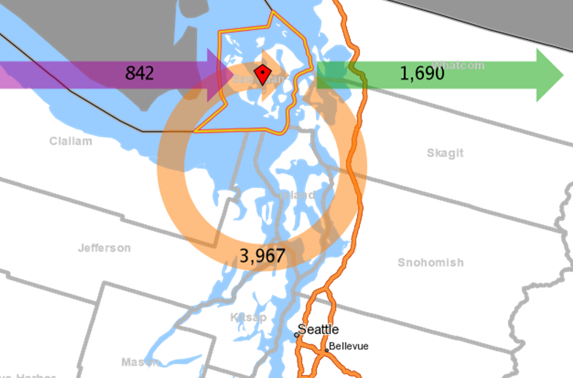
San Juan County Commute Patterns
Combining ESD Employment Data on Jobs by Place of Work
with Federal Data on Place of Residence Yields Commuting Patterns
Notes:
Independent Survey data on work commutes by Census Transportation Planning Products suggests that the commuter Outflow may be overstated. OTM is partially algorithmic and some employers may misstate the place of worker duties at a headquarters location instead of the actual place where the work was performed---these would be the major sources of possible inaccuracies.
http://ctpp.transportation.org/Pages/3yrdas.aspx

Slide 37
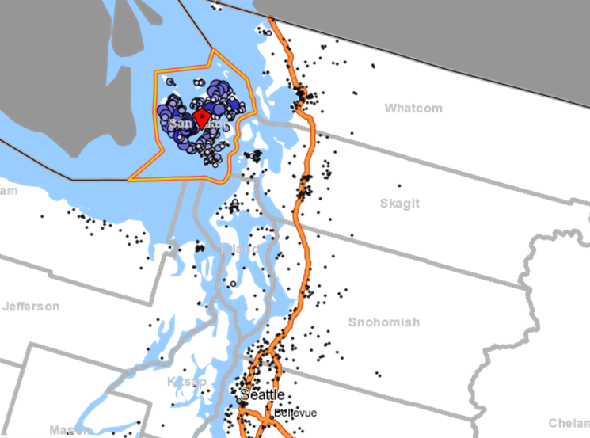
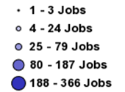
San Juan County Commute Patterns:
Work Destinations of San Juan Workers

Slide 38
San Juan County Work Commute Patterns
Net Outflow: Industry Destinations
Source: Employment Security Department/LMEA/OnTheMap
Notes:
For example: There is a 86 construction worker net worker inflow to San Juan; A 60 net worker outflow for retail trade.
There is a net outflow of 848 workers from San Juan County

Slide 39
EVENT
Event: 'EMPLOYMENT DATA PRESENTATION WITH REINHOLD GROEPLER'
Orcas Island
Date: Thursday, March 08, 2012 - 9:00 am 9 to 10:30 am at Eastsound Fire Hall Thursday, March 8
What were the final numbers for employment in San Juan County in 2011? What will the trends be this upcoming year? Join Washington State's Regional Labor Economist, Dr. Reinhold Groepler, as he discusses employment trends and future in San Juan County.
His presentation will cover labor force and employment data from 2011, likely trends in 2012, as well as commuting patterns. It will include a discussion of, and tables for, the occupations and demographics for the unemployed of San Juan County and the region.
https://www.sanjuanislander.com/calendar/month-by-month/view/21688/date/2012-03-08/214?tmpl=component

